Slide 1

ASR Medical Speech-to-Text
Medical Speech-to-Text System for Real-Time Clinical Documentation
-Eshwar Chandra Reddy Mulka
-Aarushi Pandey

Slide 2

Project Overview & Objectives:
Goal: Develop an Automatic Speech Recognition (ASR) system to transcribe doctor-patient interactions in English.
Key Challenges:
Finding suitable dataset.
Handling specialized medical terminology.
Matching transcripts to ground-truth data that uses English literals for medical terms.

Slide 3
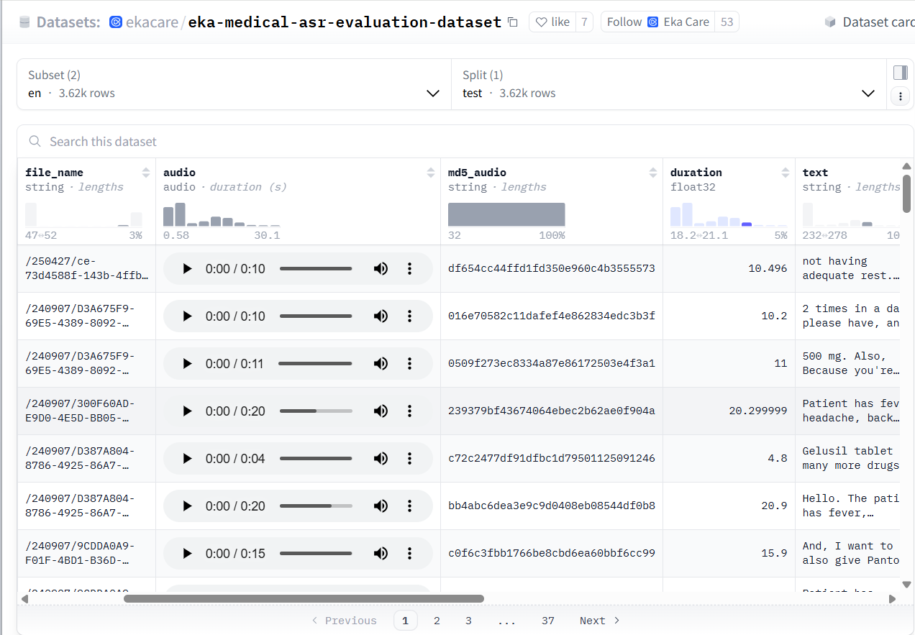
Dataset Exploration
After exploring various websites, we found a dataset from Eka-care lab on Hugging Face, (and a few on Kaggle, but proceeded with eka-care).
Primary Dataset: Eka-Care Clinical Dataset.
Data Distribution:
English: ~3,600 audio recordings.
Characteristics: High-density medical vocabulary; Hinglish data contains English ground-truth labels for clinical terms (Code-mixed).

Slide 4
Whisper Model Benchmarking:
Metric | Whisper small | Whisper medium
Inference speed | Faster/ Real-time capable | Slower/ Resource intensive
Accuracy | High (comparable to med) | Marginally higher
Decision: Selected Whisper-Small due to the optimal balance of speed and performance for clinical deployment.

Slide 5
Final Architecture:
Audio
Clinical dictation
Pre-processing
Resampling to 16kHz, Noise Reduction
Whisper Small Model
Initial Inference
Gemini LLM
Medical Terminology Correction & Formatting
Final Clinical Note

Slide 6
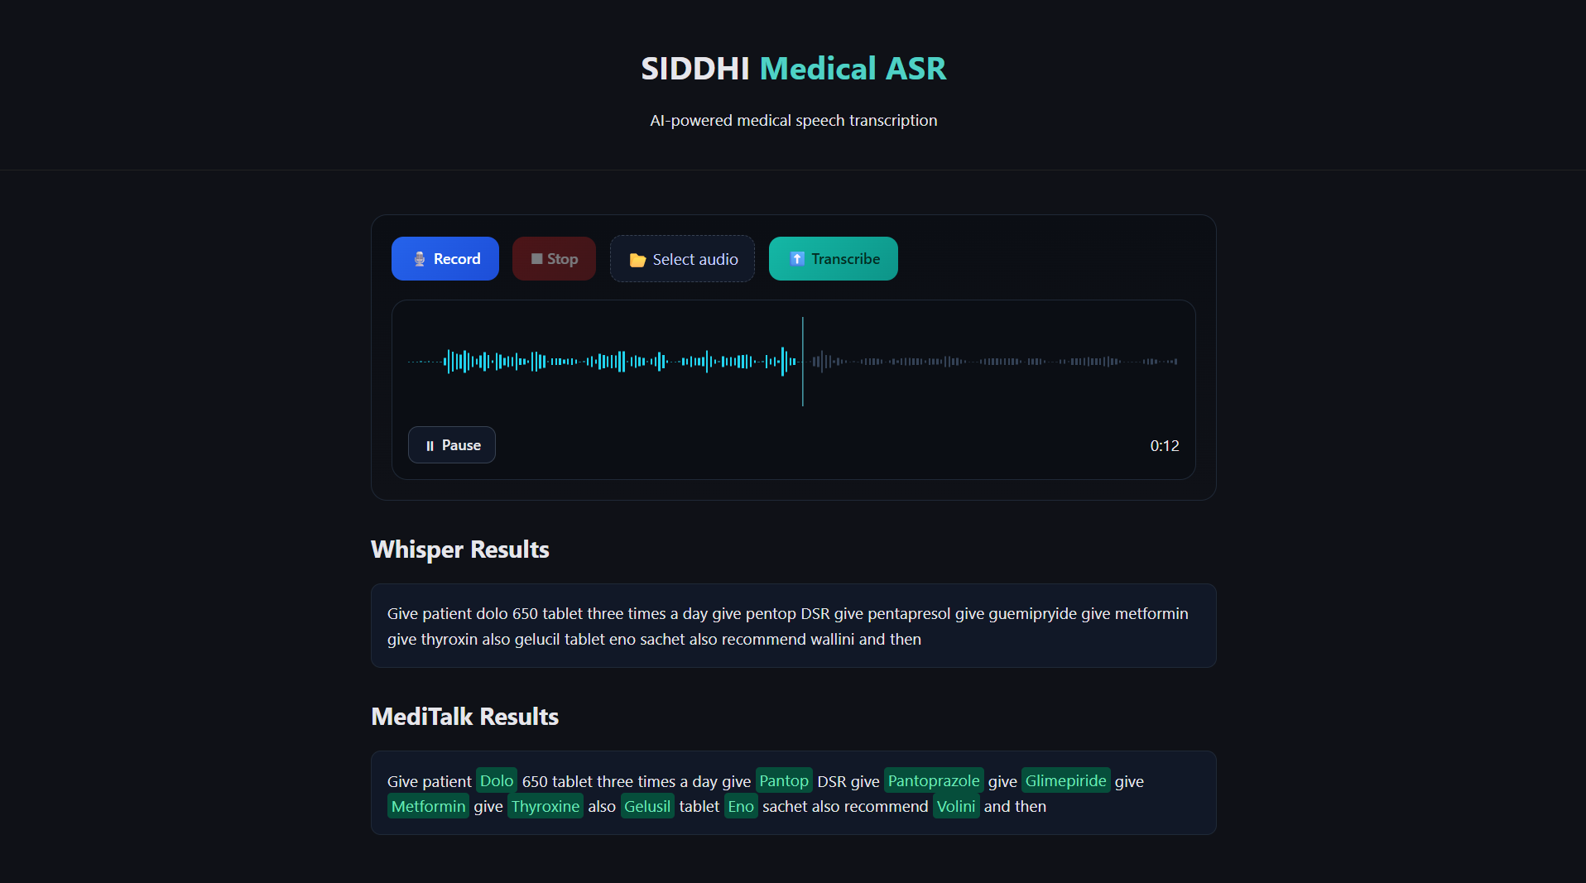
Frontend-Backend integration for current model:
A frontend was integrated with the current English pipeline. It allows recording as well as uploading audio file and returns transcription

Slide 7
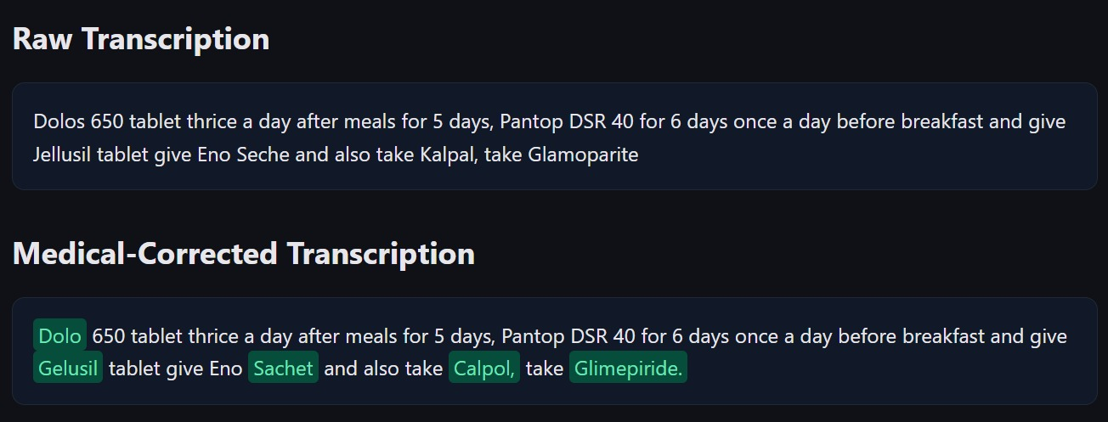
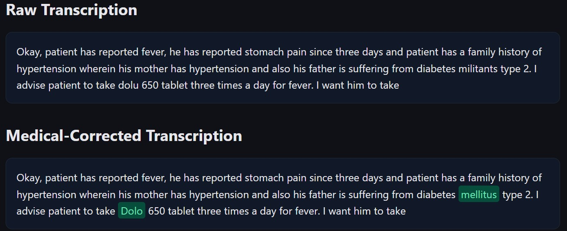
Some sample results obtained:

Slide 8
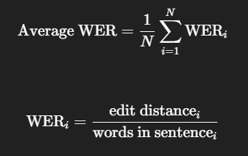

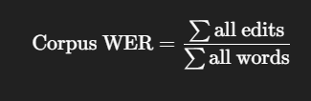
Results
Average Raw WER: 0.3201
Average Corrected WER: 0.2343
26.8% IMPROVEMENT
Corpus-level WER (better metric):
Raw Corpus WER: 0.1677
Corrected Corpus WER: 0.1400
16.5% IMPROVEMENT

Slide 9
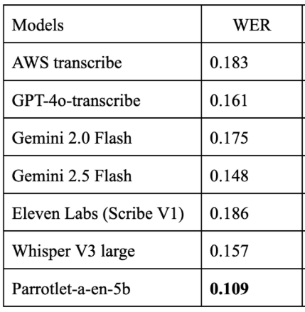
Comparison with SOTA Models:

